Slide 1
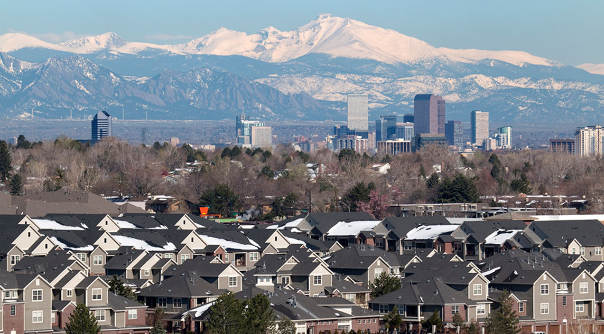
Real Estate Analysis – Denver, CO and the US
Noah Laraway
IST 652
9/8/2021

Slide 2
Contents
Overview
Data Sources
Description of the Program
Analysis questions
Conclusion
Appendix A
Resources

Slide 3

Overview
Why real estate as a topic?
Hot market across US: Home prices nationwide grew by 17.2% in June 2021 compared with June 2020—a record high (source: Forbes)
In August 2021, Denver home prices were up 19.6% compared to the previous year (source: redfin)
Project scope: To collect and analyze data to look for trends in real estate prices for Denver and the US as a whole.

Slide 4


Data Sources
US Median Sales Price Data
Data from the US census website: census.gov
Excel file containing 30 rows and 11 columns
Data shows median and average sales prices for:
Entire US
Northeast, Midwest, South & West
1999-2020
Denver Median Sales Price Data
Data from the Denver open data: Denver Open Data
CSV file containing 321k rows and 15 columns
Data shows individual real estate sales
2010-2021 YTD

Slide 5
Description of program
Importing, inspection & cleaning
Brought in both files using Pandas
Inspected data
Found unnecessary data columns and rows
Found incorrect data types
Cleaned data and created new data frames
Analysis
Merged clean US and Denver data frames
Created updated data frames using aggregates and group by functions to answer questions
Performed time series analysis to forecast housing prices for the US
Created visualizations to support findings

Slide 6
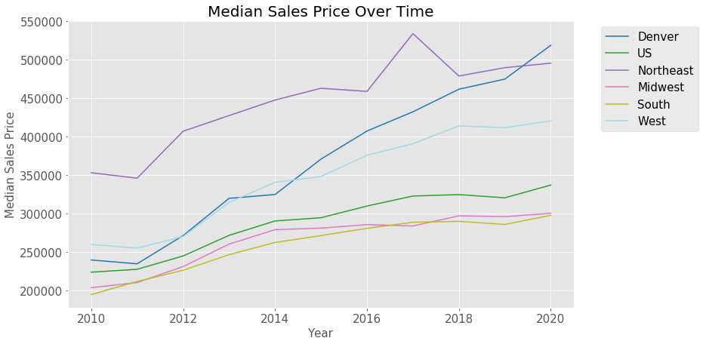
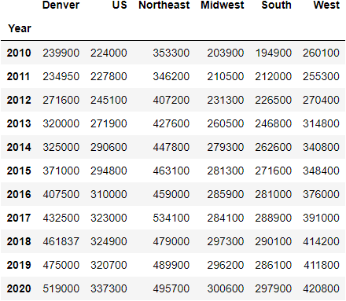
Analysis Question#1
How have home prices in Denver and the US changed over time (2010-2020)?

Slide 7
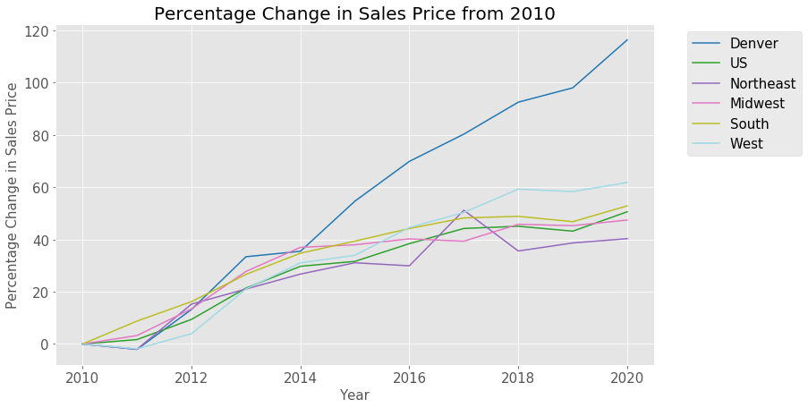
Analysis Question#1 (continued)
How have home prices in Denver and the US changed over time (2010-2020)?
All regions showed increases of at least 40%. Denver far outpaced the US at an increase of 116% over the time frame.

Slide 8
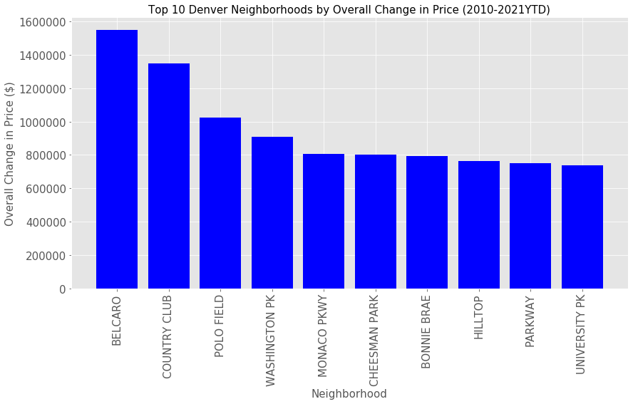
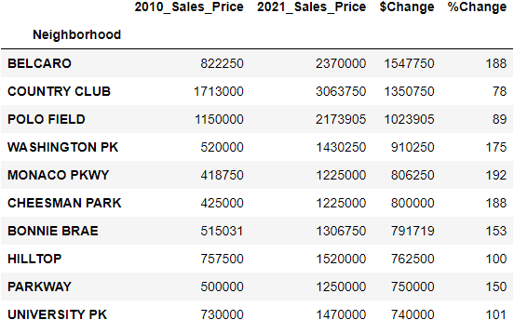
Analysis Question#2
What were the top 10 neighborhoods in Denver by change in median sales price over time (2010-2021YTD)?

Slide 9
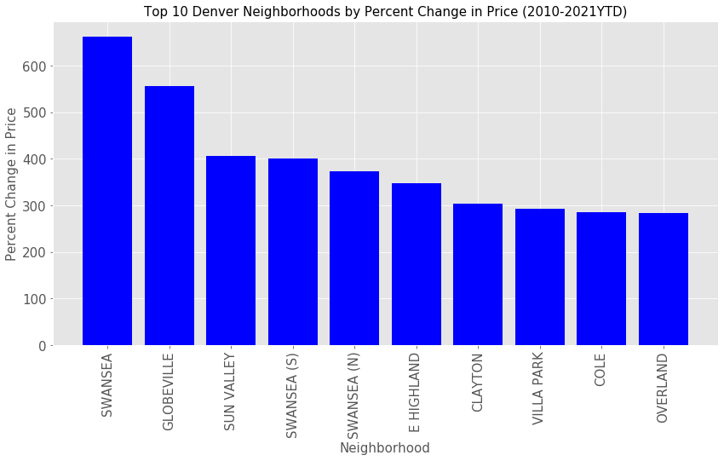
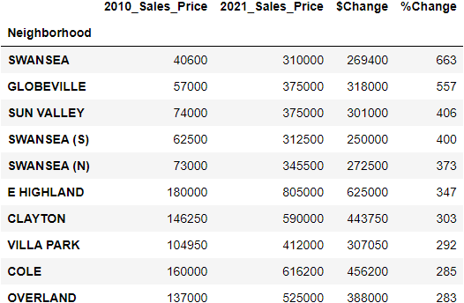
Analysis Question#2 (Continued)
What were the top 10 neighborhoods in Denver by percent change in sales price over time (2010-2021YTD)?

Slide 10
Conclusion
Inspecting and cleaning data is critical
Don’t want to find data issues during analysis
Analysis
Median home sales prices increased drastically in the US in all regions from 2010-2020
Denver far outpaced the US as a whole at a 116% increase
Affluent neighborhoods in Denver saw the largest increase in overall price
Lower socioeconomic neighborhoods saw the largest percent increase in price. More than likely due to gentrification of those neighborhoods.
Next steps
Continue to add future data to see how prices evolve over time
Incorporate data for other cities to see how it compares

Slide 11
Questions?

Slide 12
APPENDIX A
Resources
census.gov: The Census Bureau's mission is to serve as the nation's leading provider of quality data about its people and economy.
Denver Open Data: The Denver Open Data Catalog provides open access to data managed by the city of Denver.
Forbes: Forbes is a global media company, focusing on business, investing, technology, entrepreneurship, leadership, and lifestyle.
Redfin: Redfin is a full-service real estate brokerage.

